Slide 1

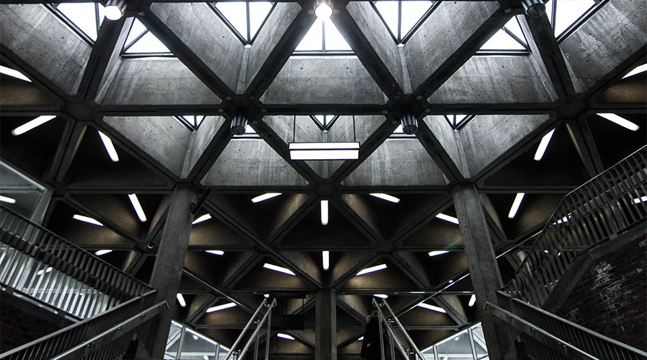


Evolution College system
2
+
An Aptech vision presentation 2022

Slide 2

DESIGN DEVELOPED & MANAGED BY
Shahzaib Abid
(Student1307355)
Charles Stephen
(student1307539)

Slide 3

1.Acknowledgement -----4 2.Problem Statement-----5 3.Problem Solution-------6 4.Requirement Analysis----7 5.Design Phase ------------8 6.Architecture of Ecs----9 7.admin panel----19 8.Evaluation/Testing---24 9.User Guide---------------25 10.Database--------------26
contents
3

Slide 4


2
+
2
+
acknowledgement
2
+
acknowledgement
We would like to thanks our centre and our teacher Sir Noman ishaq for giving us a huge opportunity to prove ourself on an amazing platform to showcase our skills.
Thank you!
Regards team members
We would like to thank our teacher Sir Noman for giving us a huge opportunity to prove ourself on an amazing platform to showcase our skills.
Thank you!
Regards team members
4

Slide 5

Problem Statement
Since Pakistan's inflation rate is rising and the bulk of its population is middle and lower-class, as costs rise, a rising number of students drop out of school after matriculation because they are unable to continue their education and must work to pay their family's monthly expenses. You must create an online college system that allows students to continue their education while receiving support from their families while studying at home during their free time.

Slide 6

Problem Solution
Students can conveniently learn online utilizing recorded lectures thanks to the Evolution College System, a college platform. They can study when they have free time. Students can manage and track their academic activities on their learning management system. Students can check their test schedule and progress online using learning management systems. Online exams are another alternative provided by the Evolution college system. To put it simply, we design all of your possibilities for the future.

Slide 7

Requirement analysis
HARWARE:
8 GB of RAM
A minimum computer system that will help you access all the tools in the projectt is i-series.
SOFTWARE:
Visual Sstudio Code
xampp
My SQL(Database)
OPERATING SYTEM:
Windows OS + Visual studio code + my sql. Use software as per project requirements.
7

Slide 8
Design phase
Design phase involves the preparation of our website which includes the following pages.
Home
About-us
LMs Login
Admission
Contact
Logout
8
18

Slide 9

Architecture of Evolution college system
Home
9

Slide 10
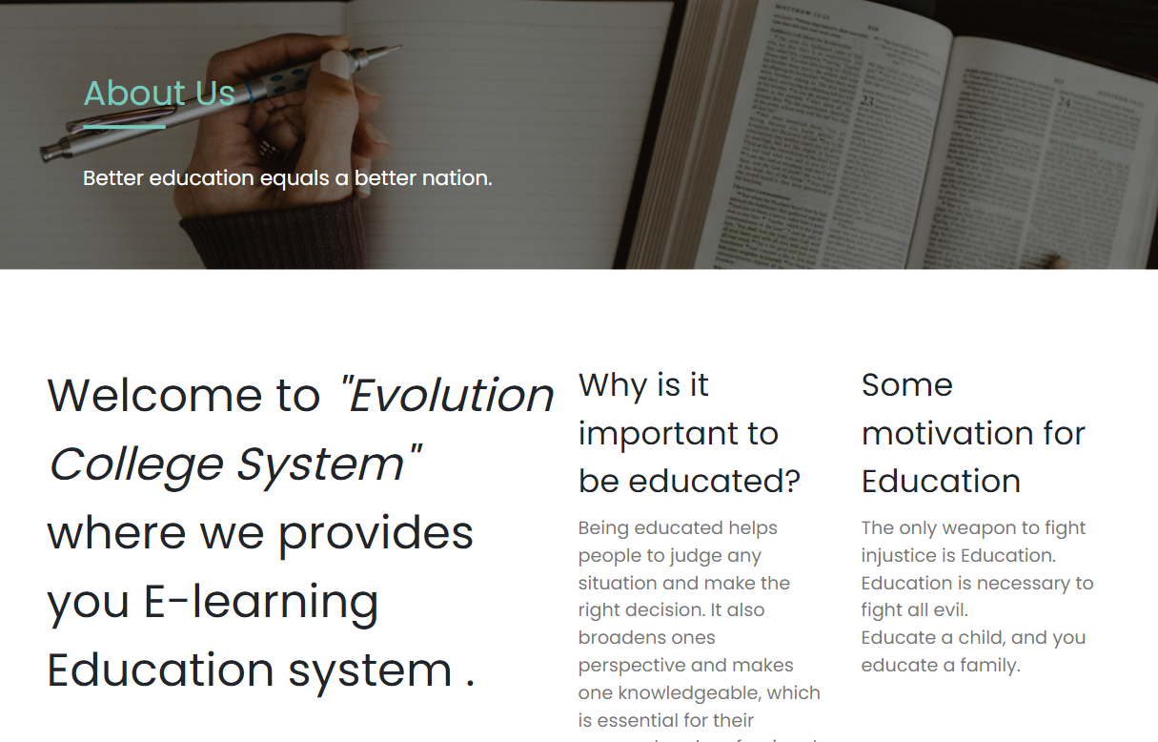
About
10

Slide 11
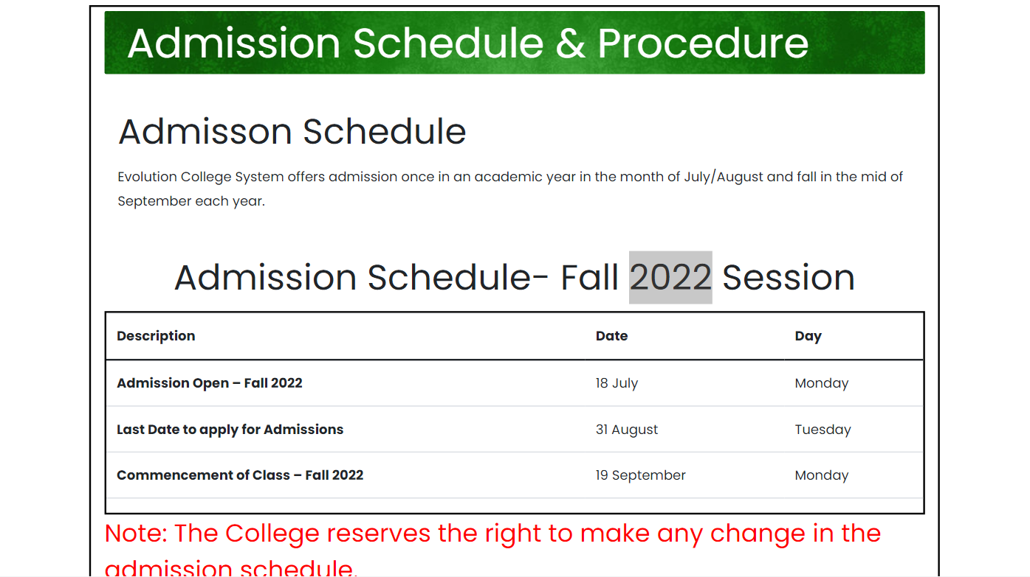
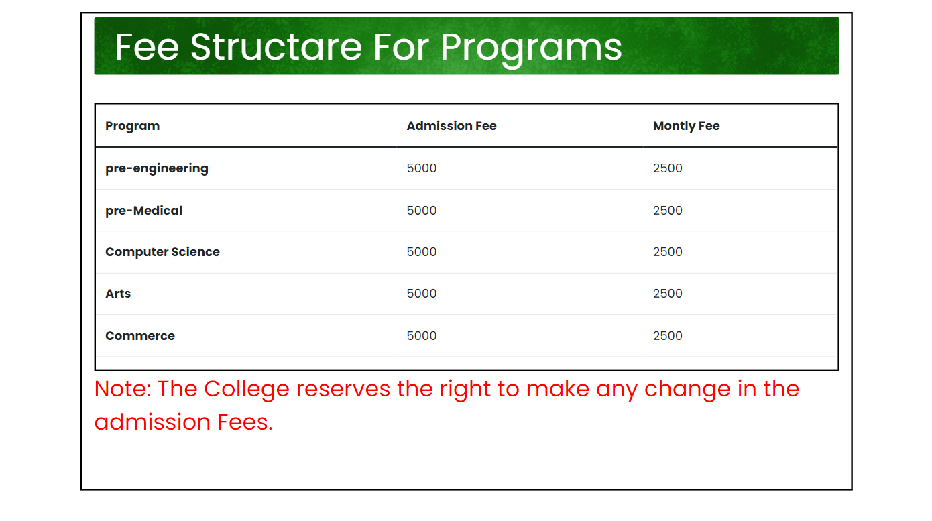
Admissions
Admission schedule
Fee structure
11

Slide 12
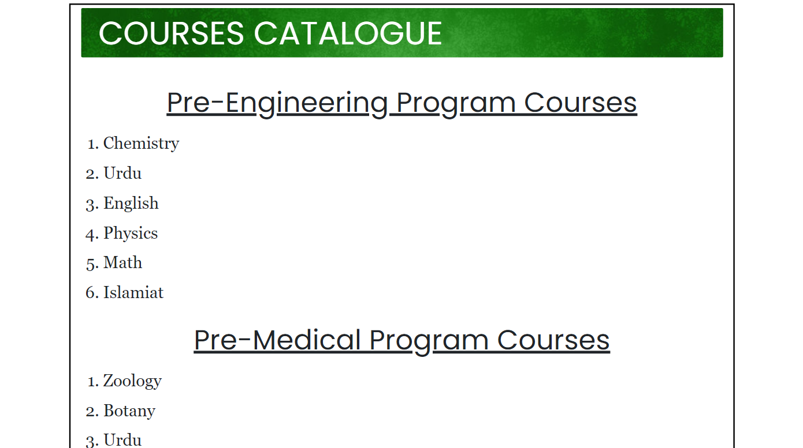
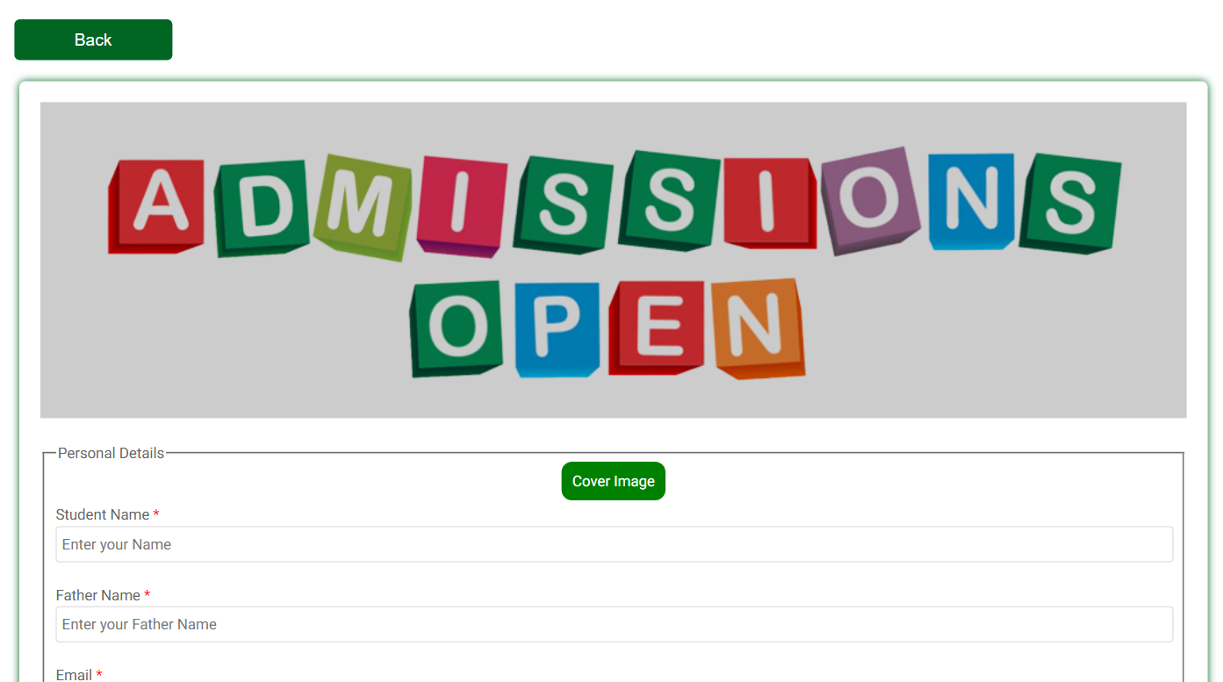
Course catalogue
Apply online
12

Slide 13
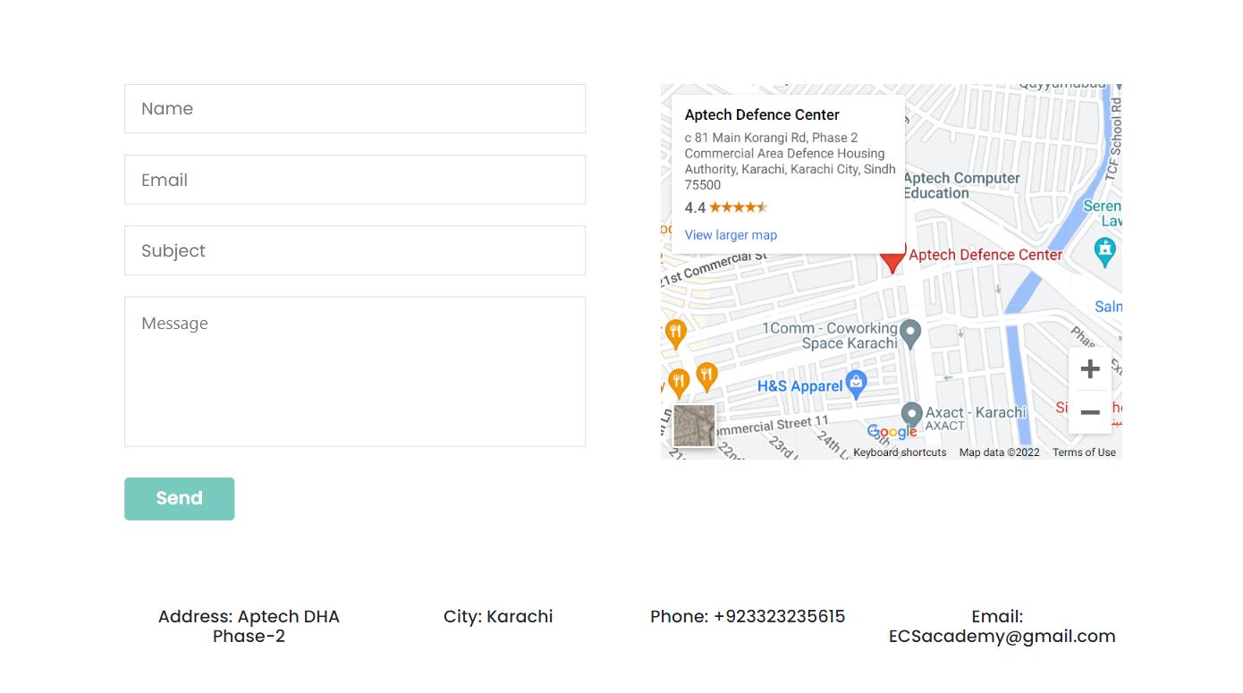
contact
13

Slide 14
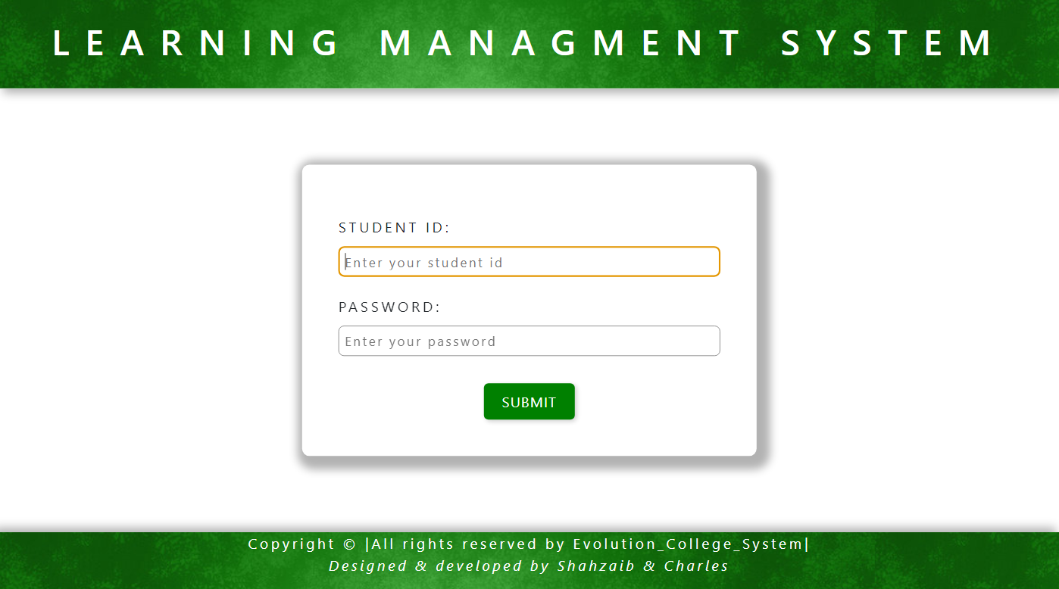
Learning management system
Lms Login
14

Slide 15
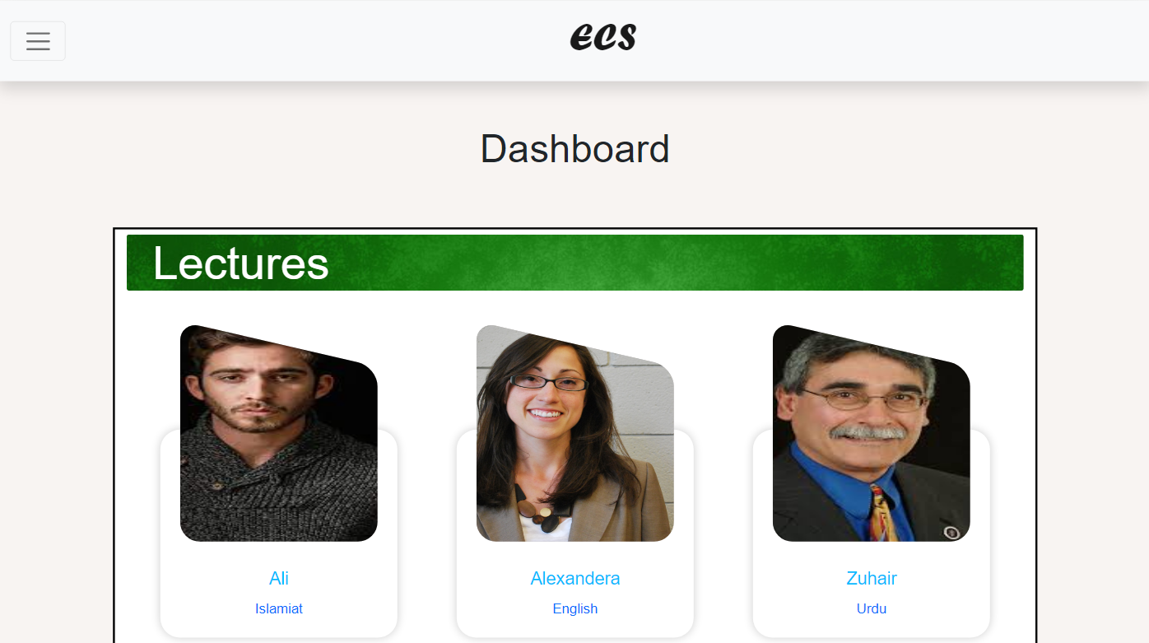
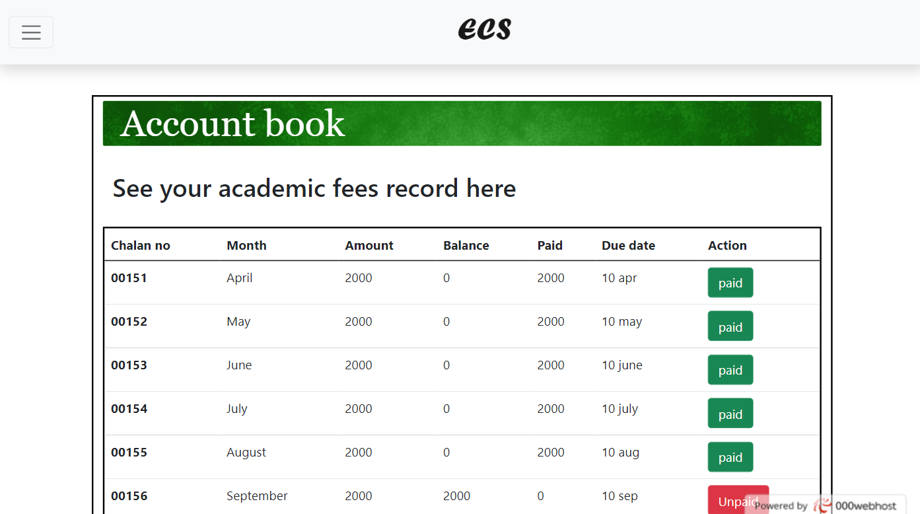
Home
Account book
15

Slide 16
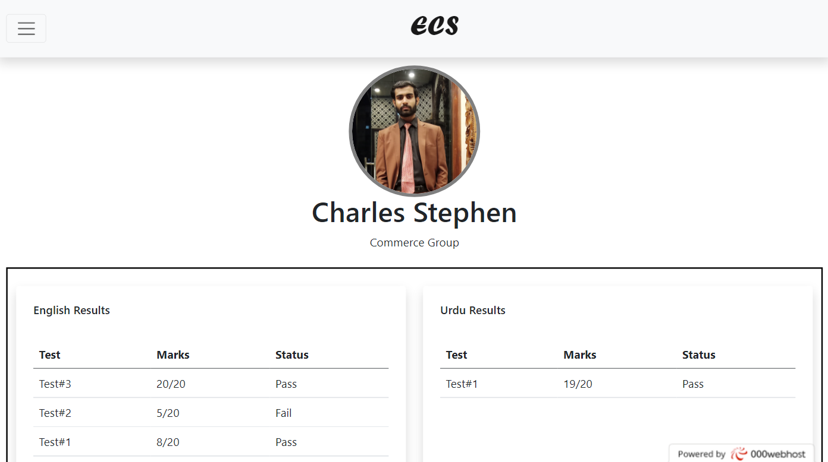
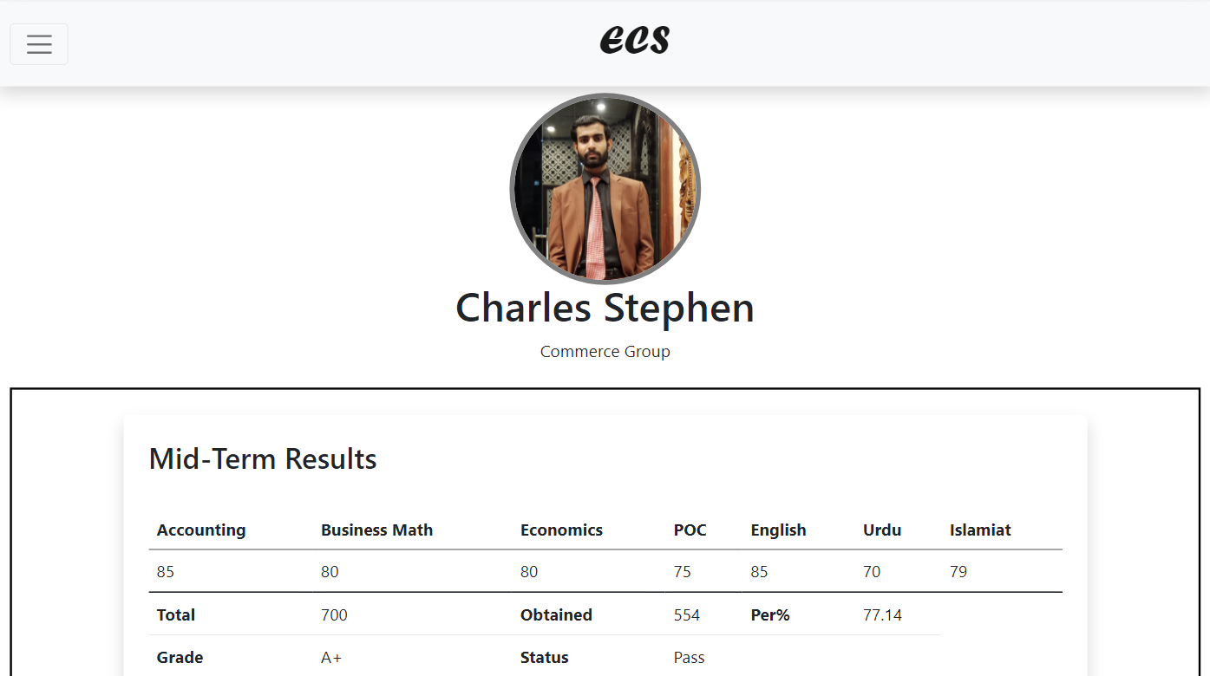
Test progress
Mid/final progress
16

Slide 17
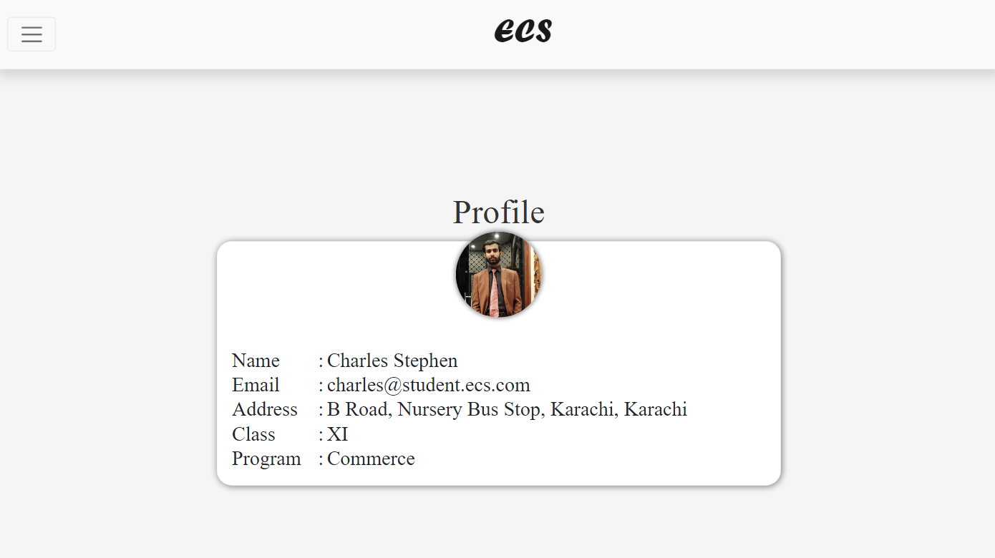
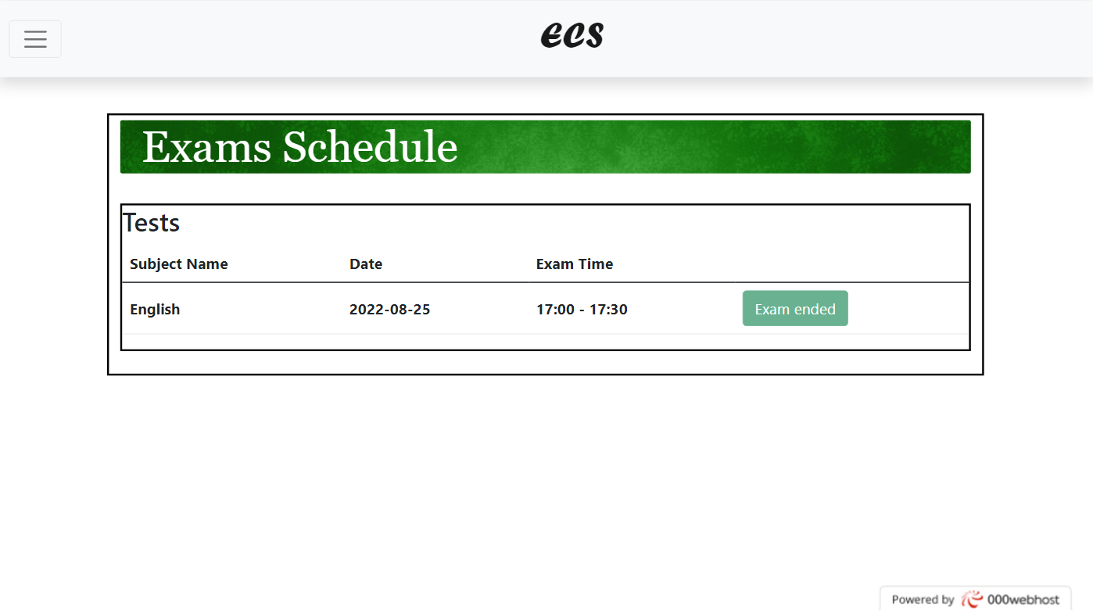
profile
tests
17

Slide 18
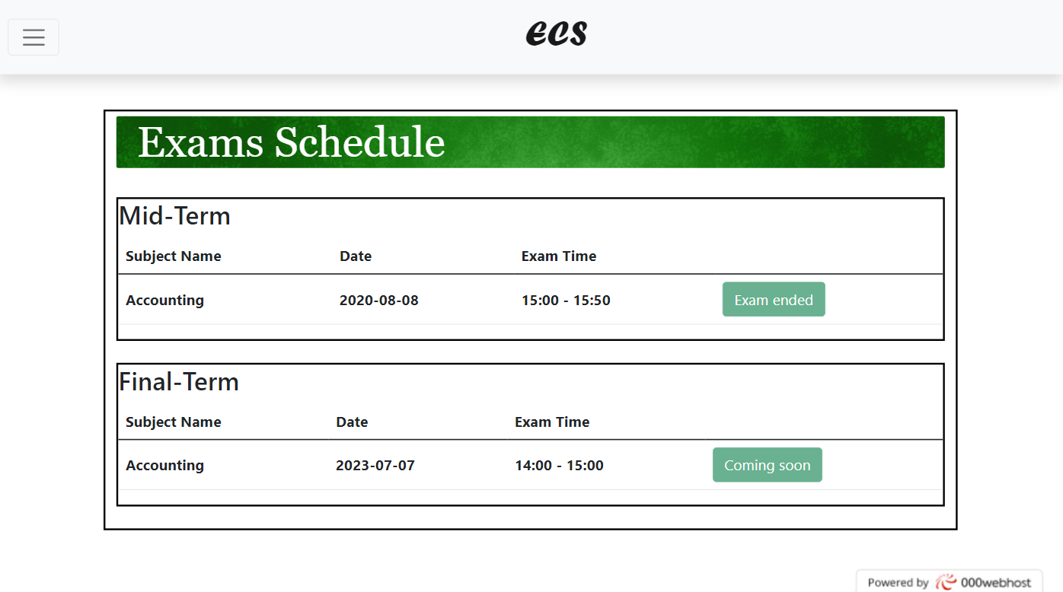
exams
18

Slide 19
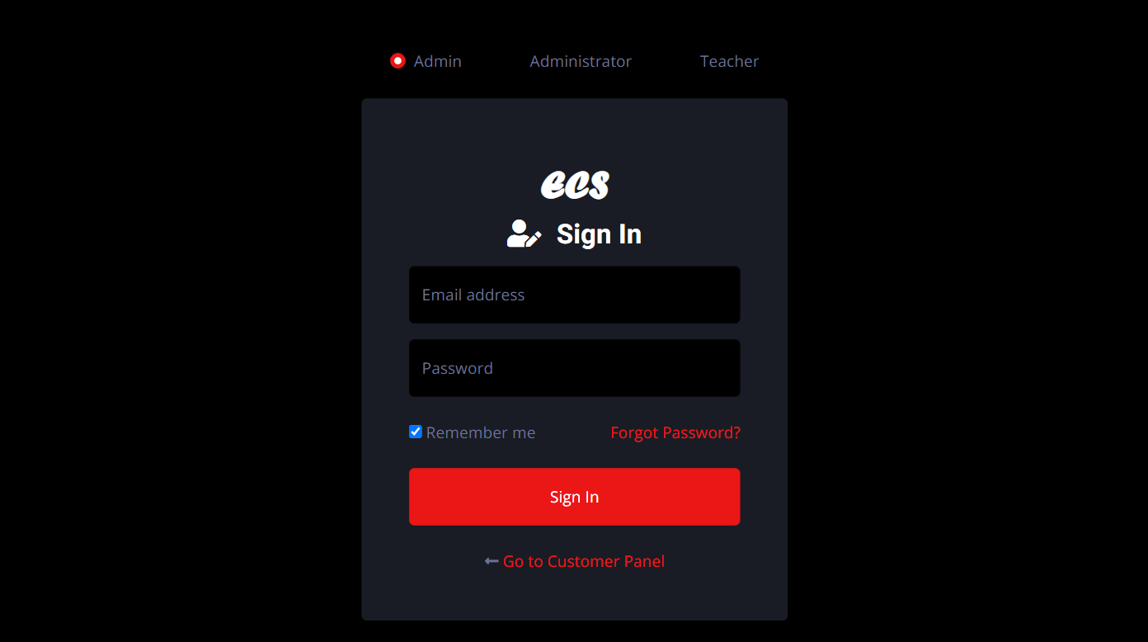
Architecture ofadmin panel
Administrator login
19

Slide 20
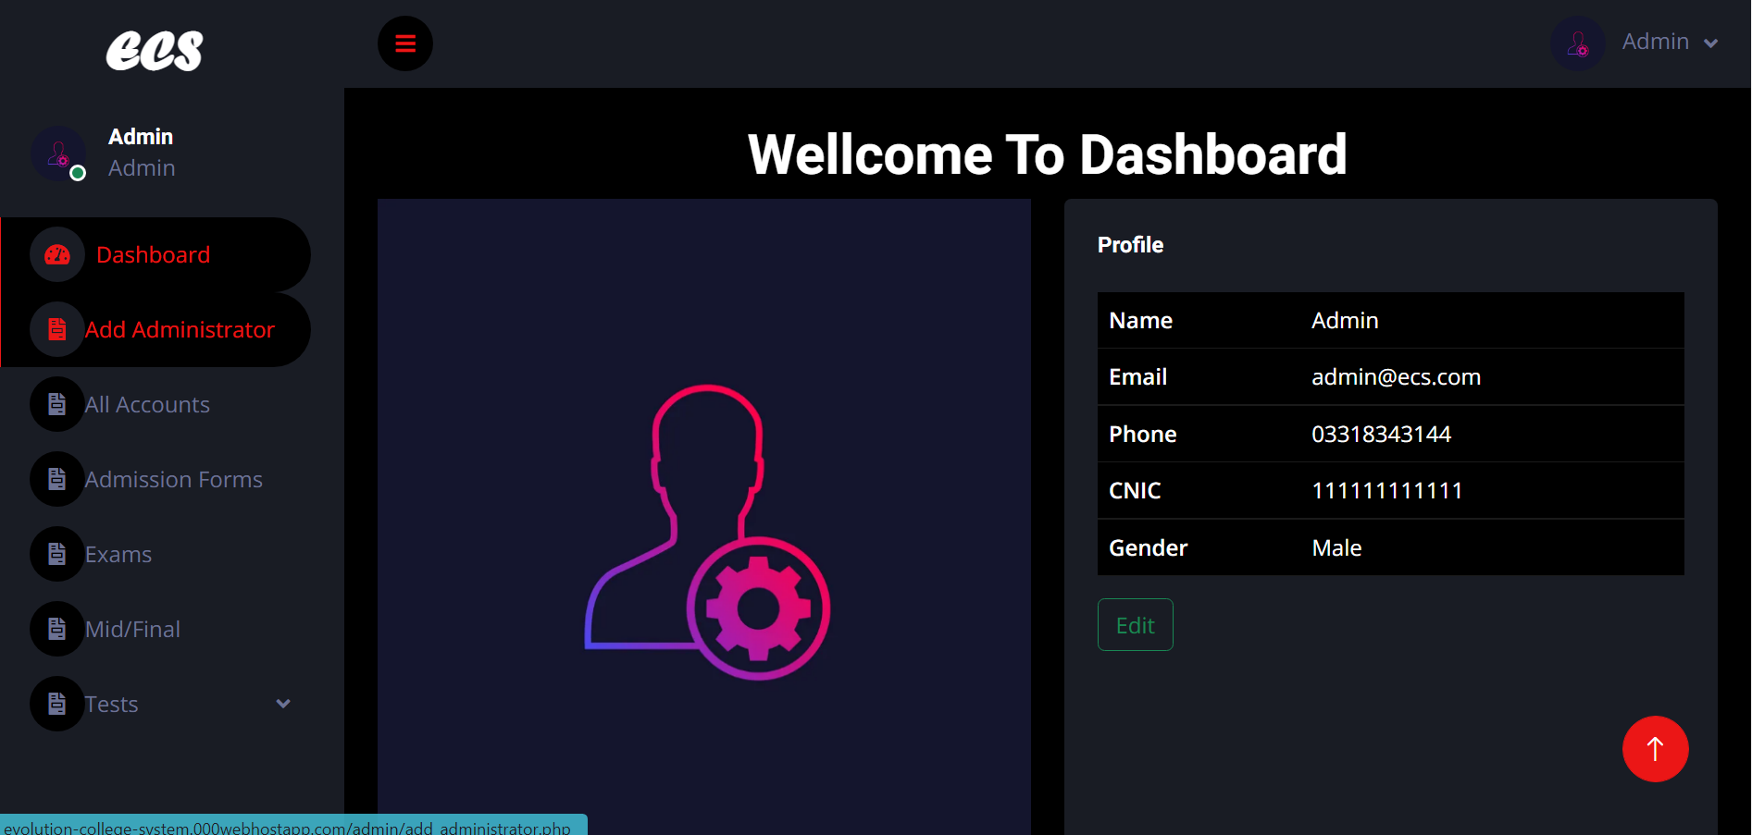
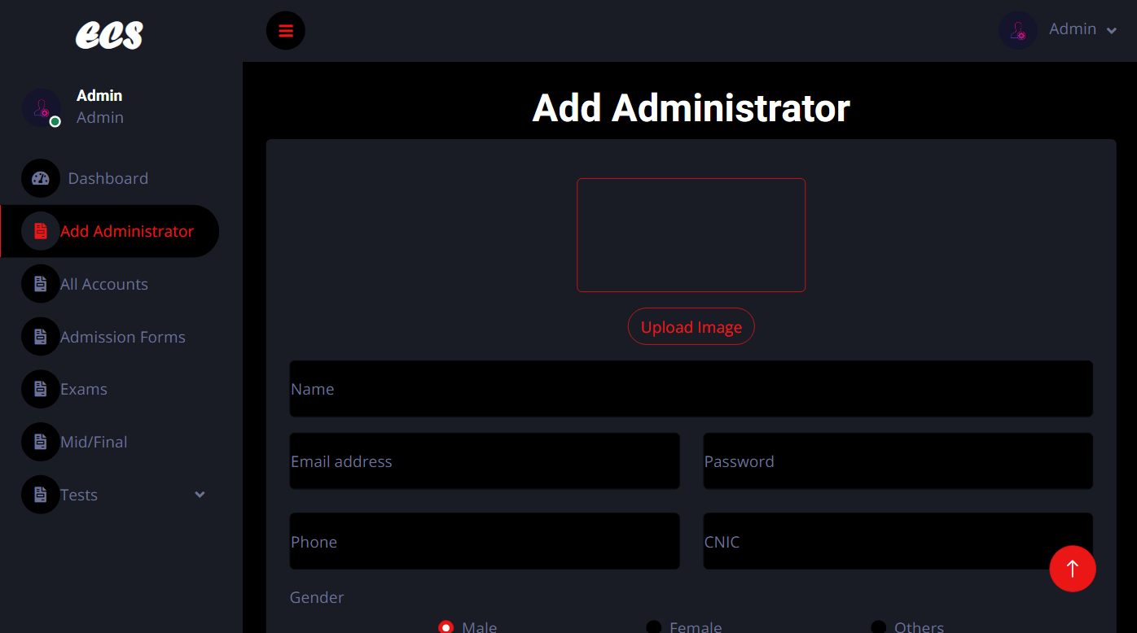
Dashboard
Add administrator
20

Slide 21
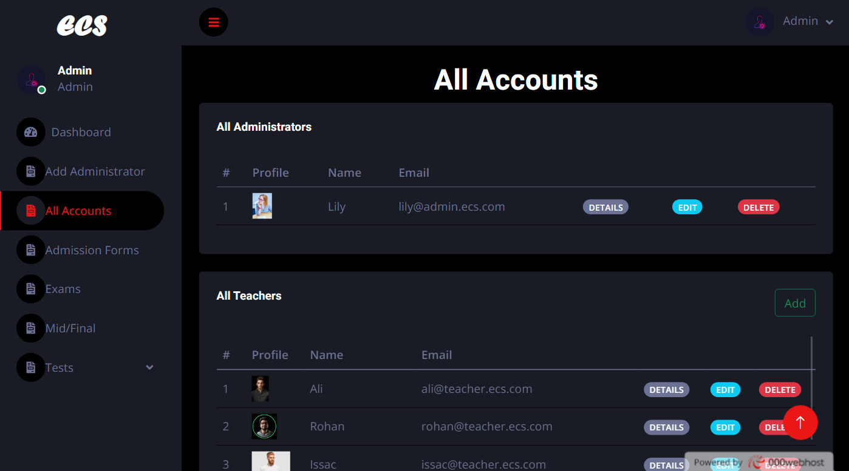
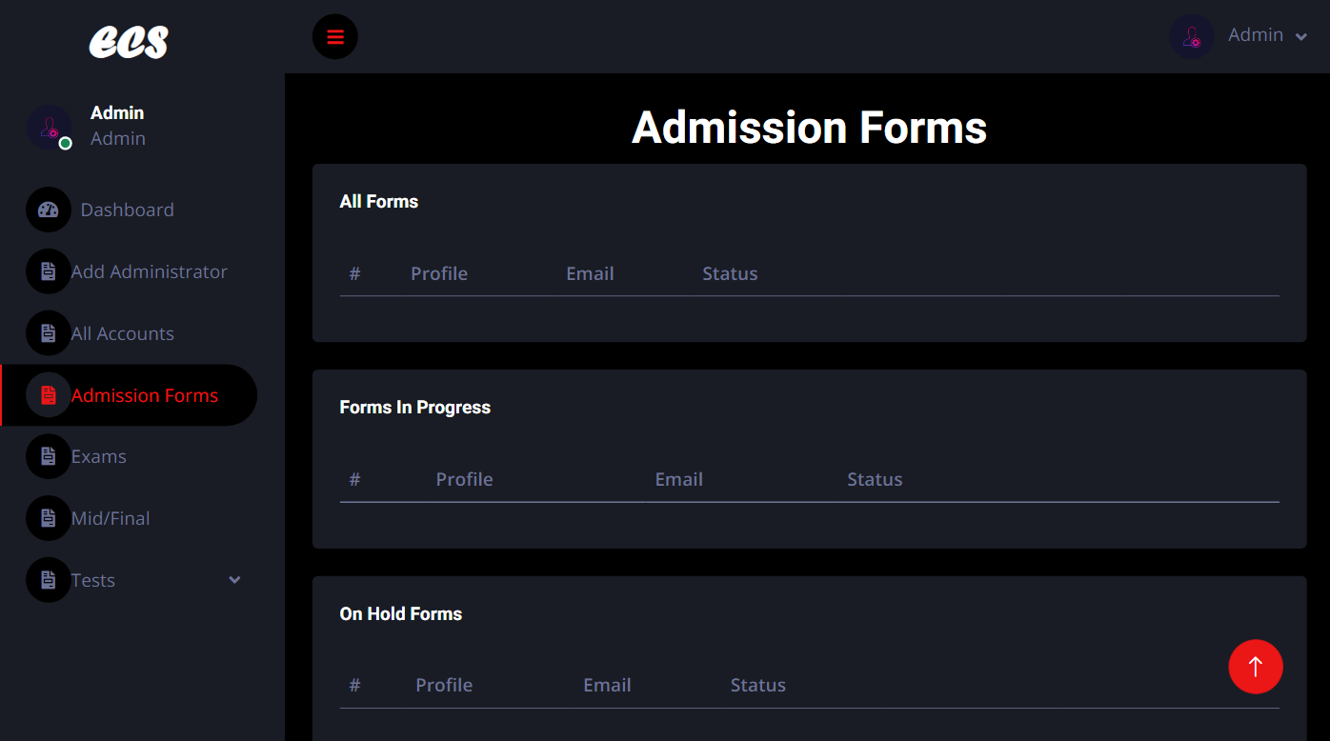
All accounts
Admission forms
21

Slide 22
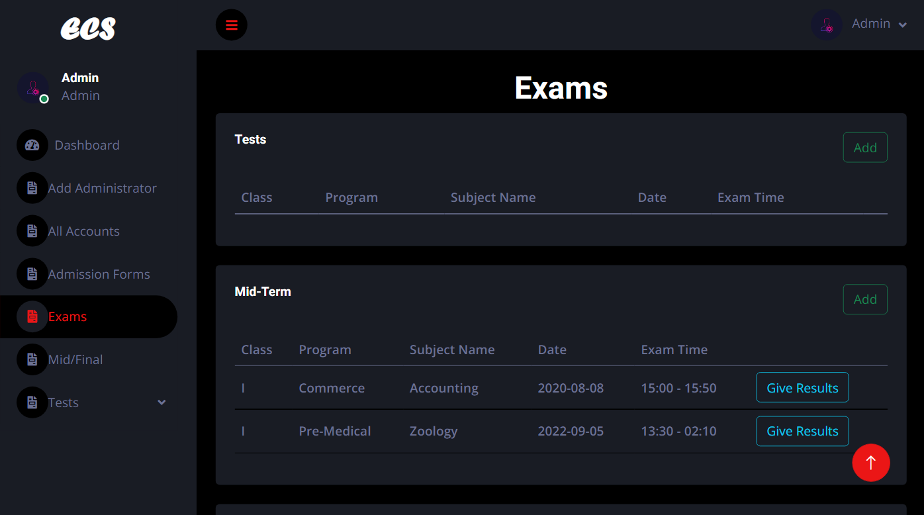
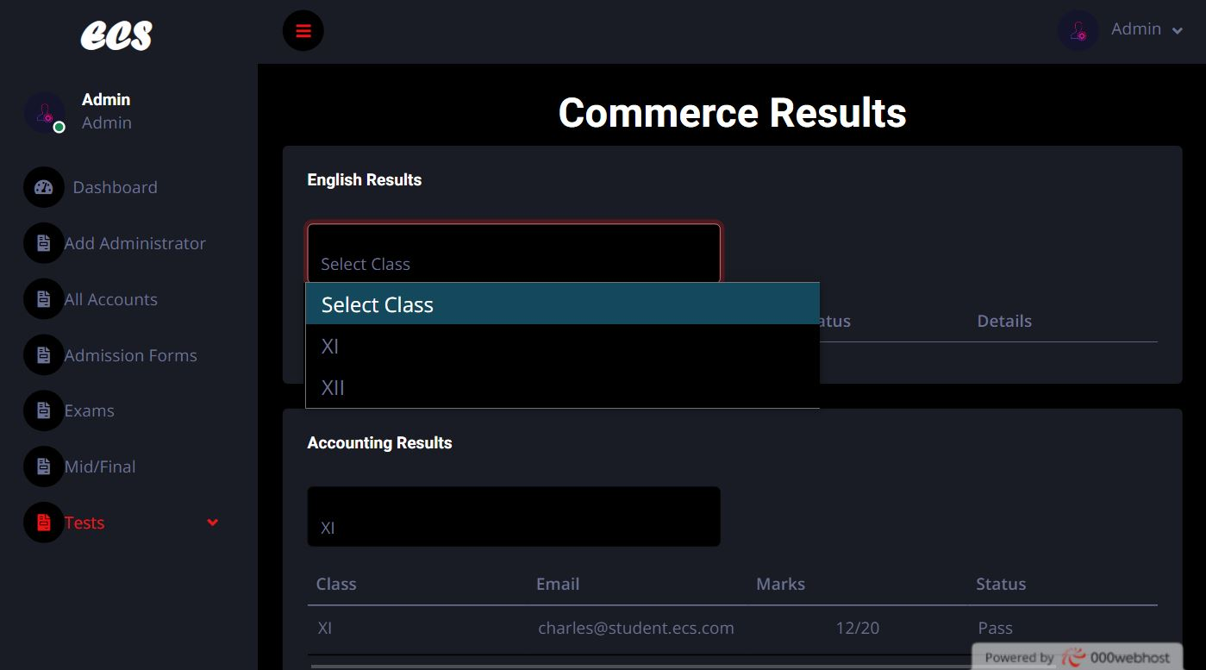
exams
test
22

Slide 23
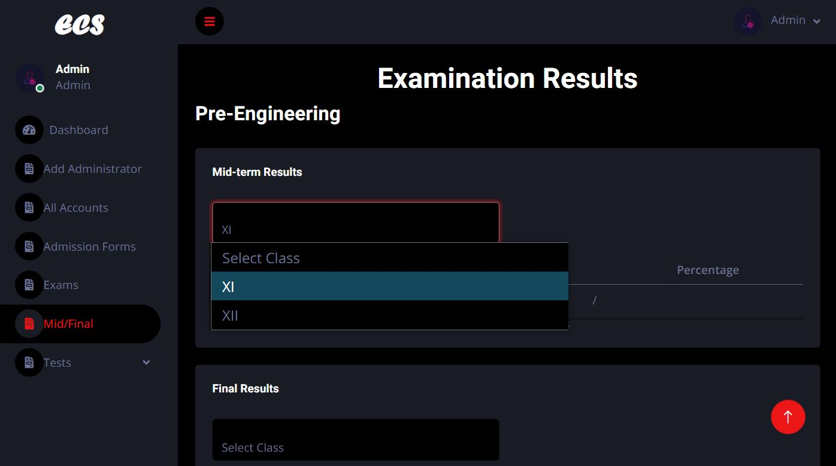
Mids./final
19

Slide 24
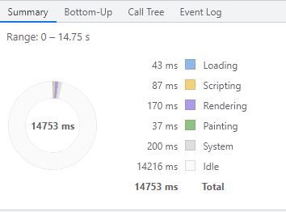
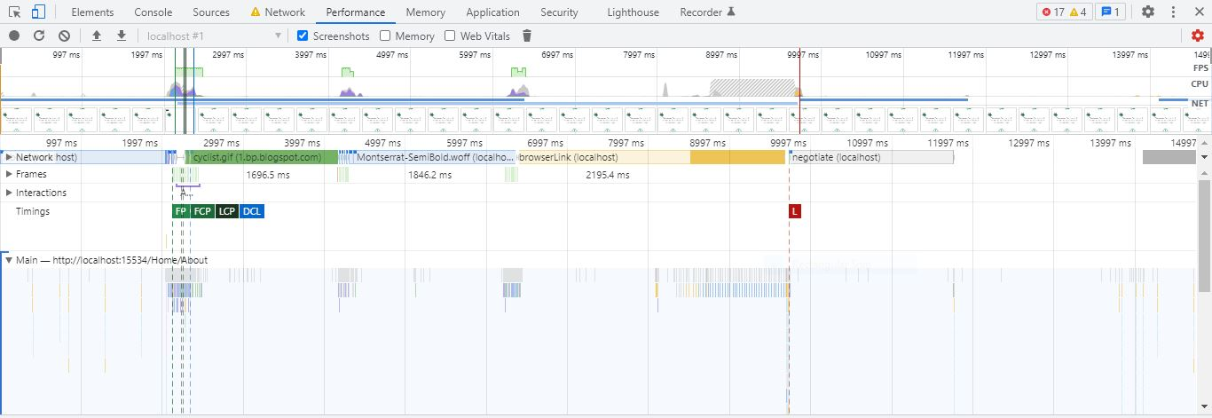
Evaluation|testing
Web performance
24

Slide 25
User guide
All pages are linked on the top bar of website.The top bar pages include following:
Home
About-us
LMS Login
Admission
Contact
Logout
25
18

Slide 26
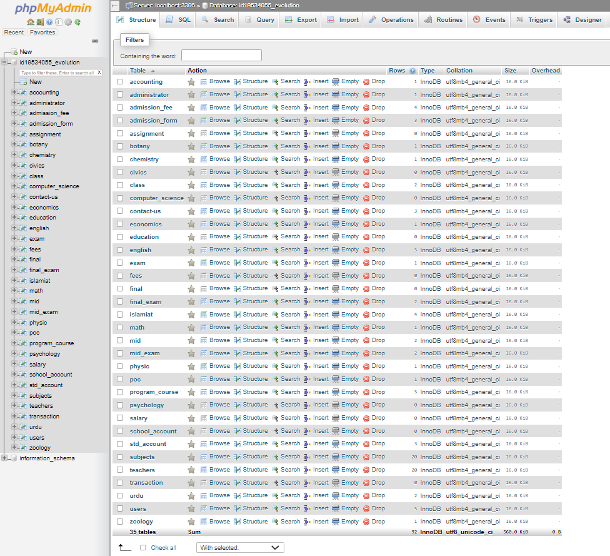
database
26

Slide 27
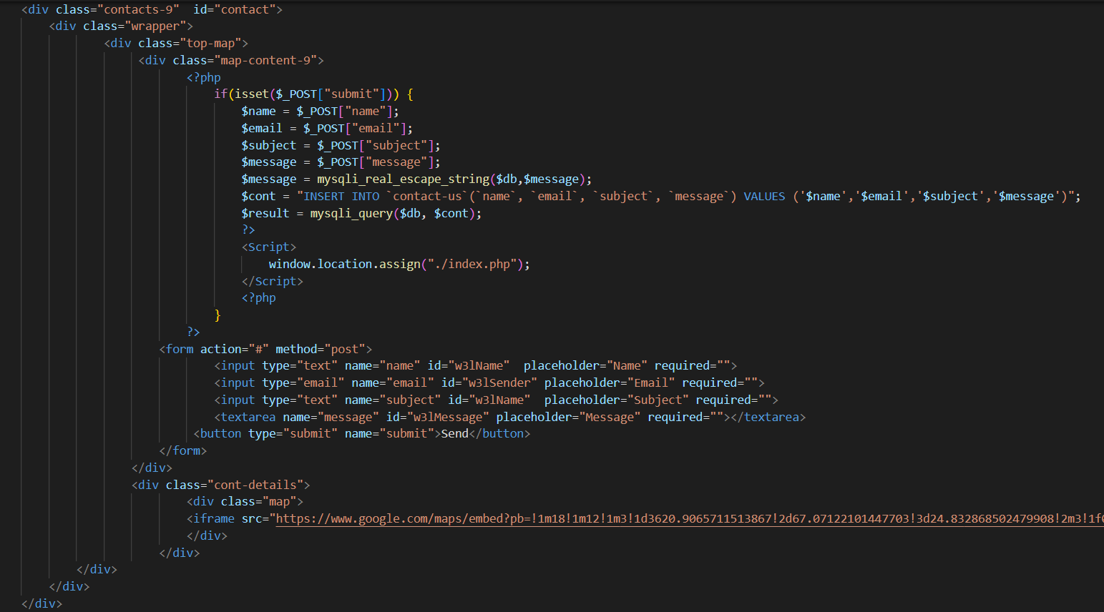
Source code:
user
contact
14

Slide 28
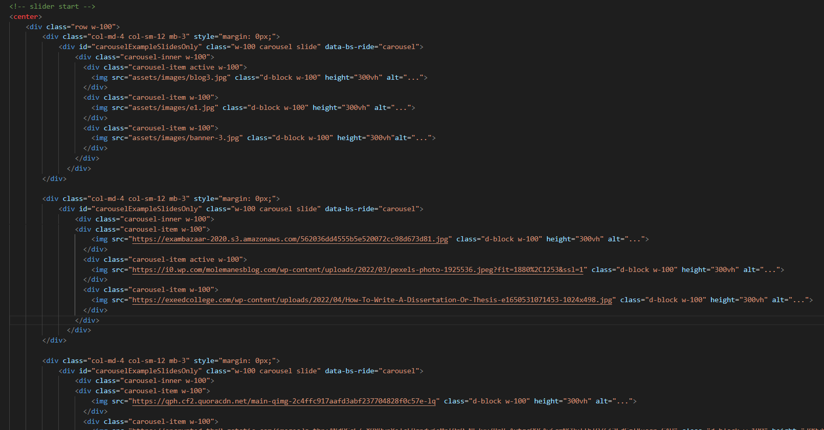
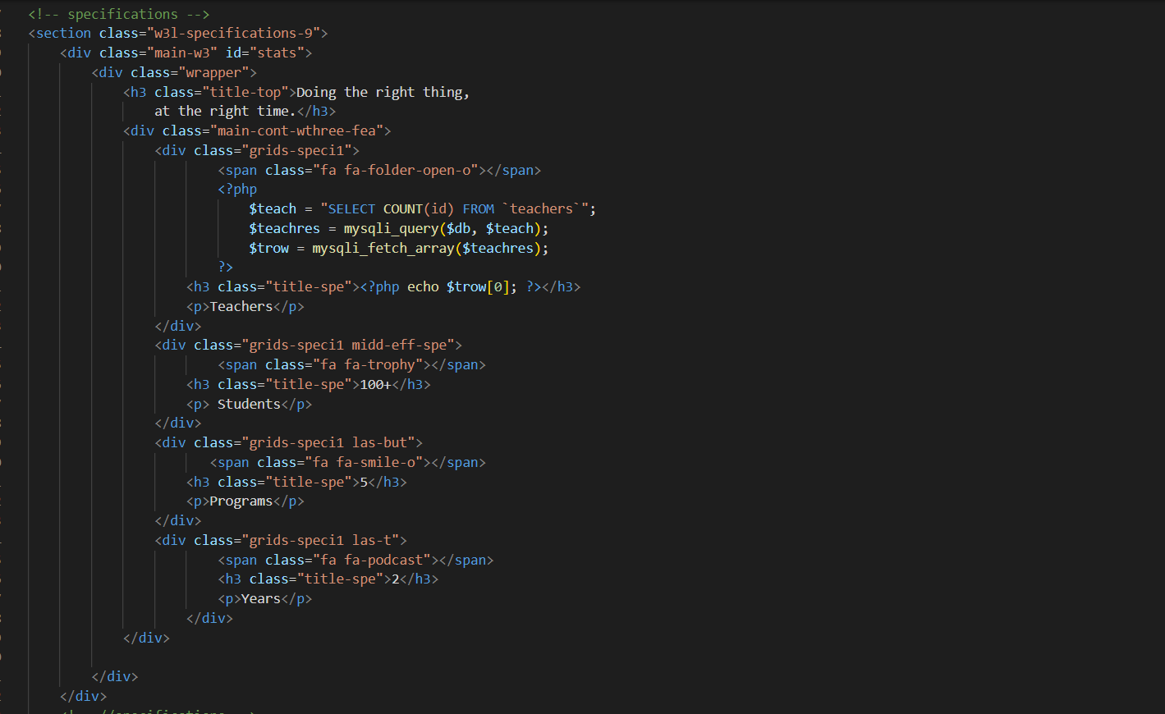
home
About
22

Slide 29
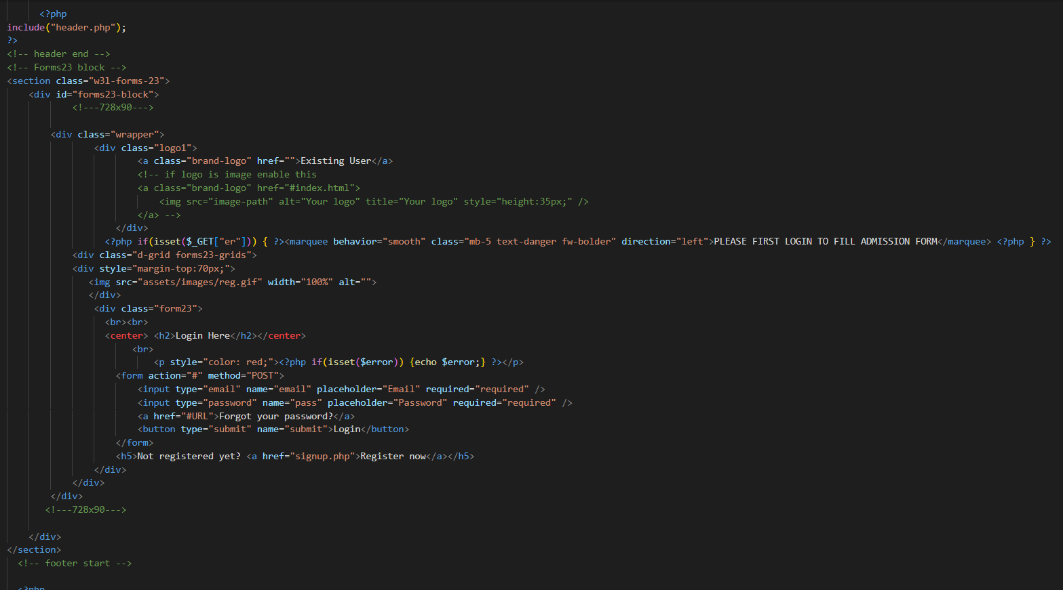
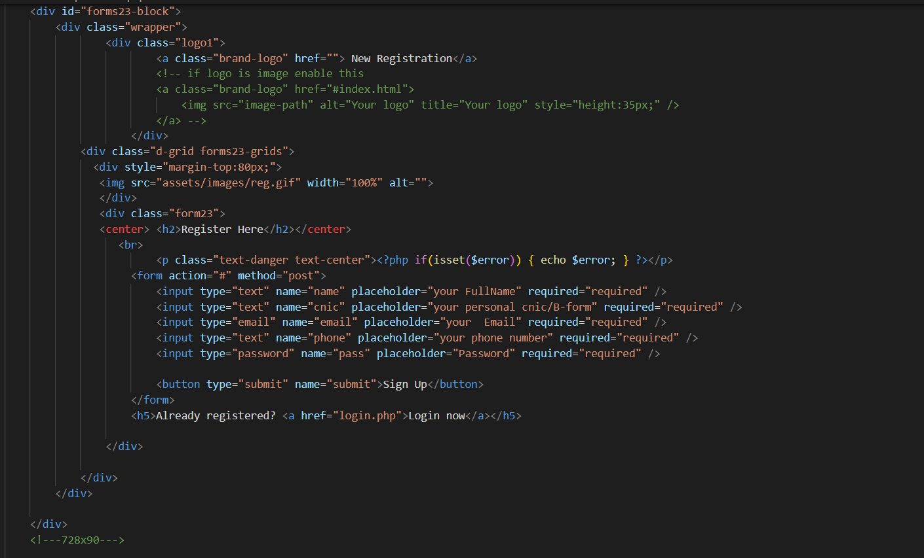
Login
Signup
22

Slide 30
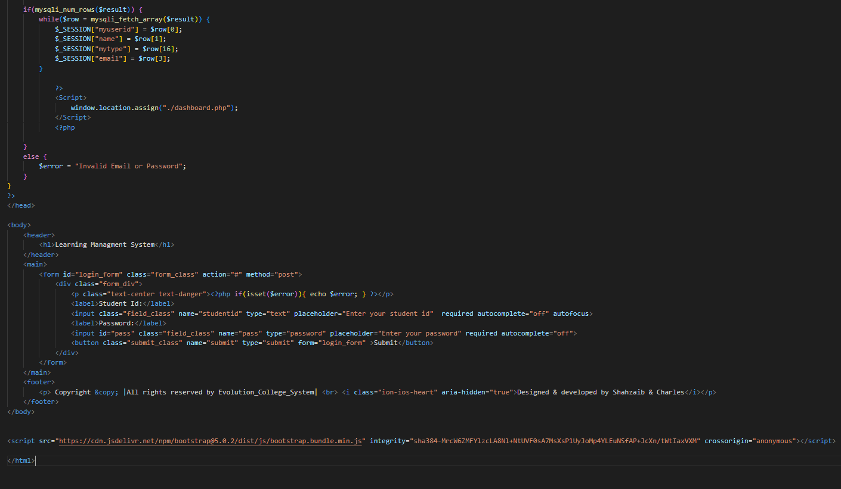
Learning management System
Login
14

Slide 31
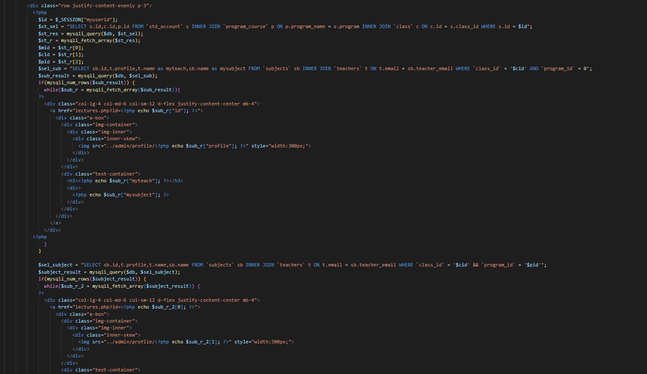
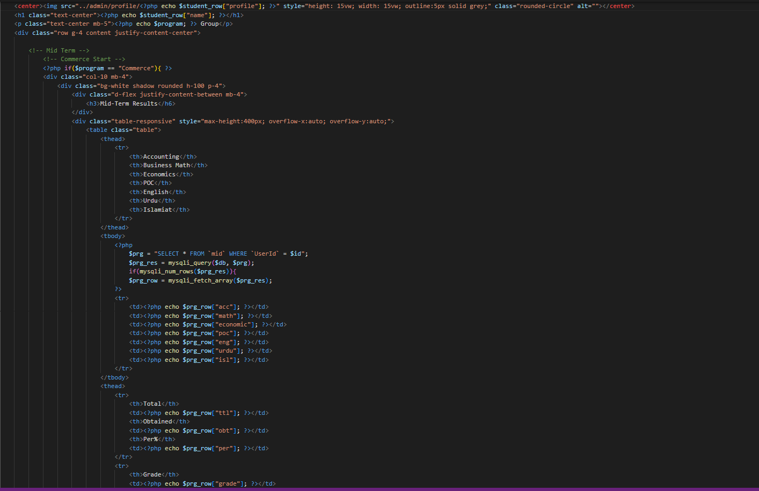
Dashboard
Mid/final Result
22

Slide 32
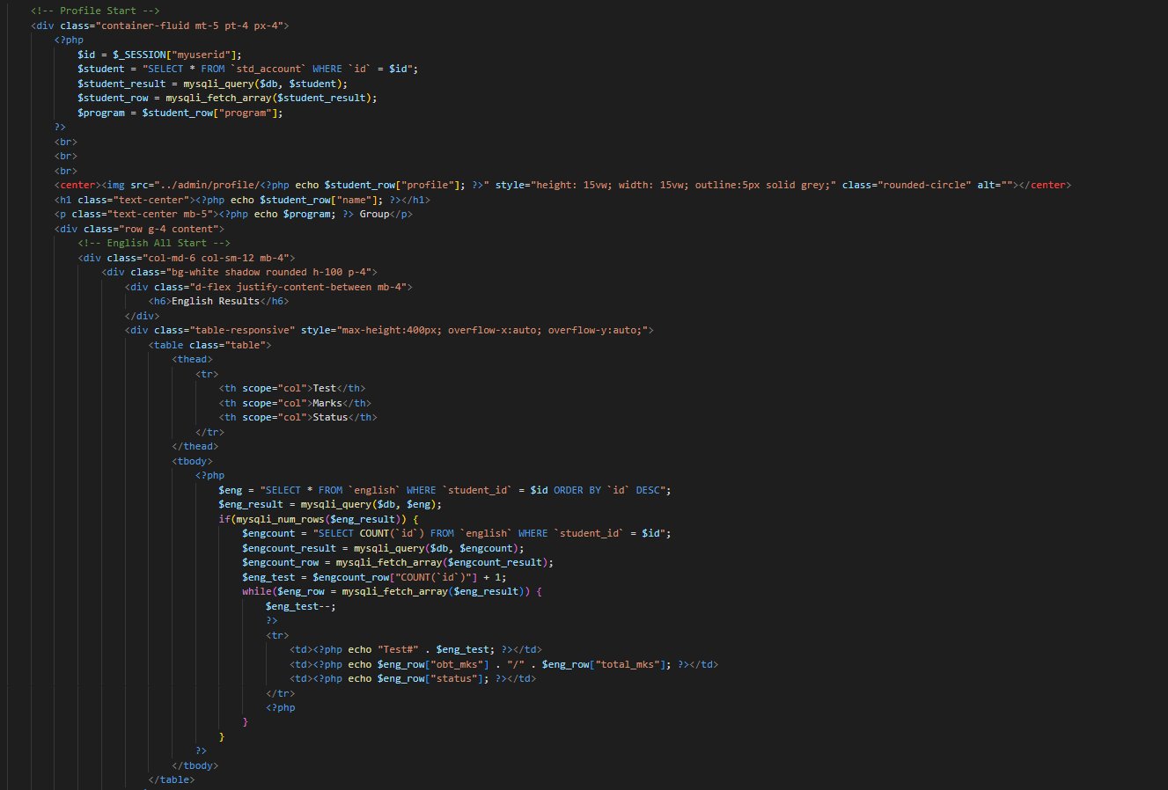
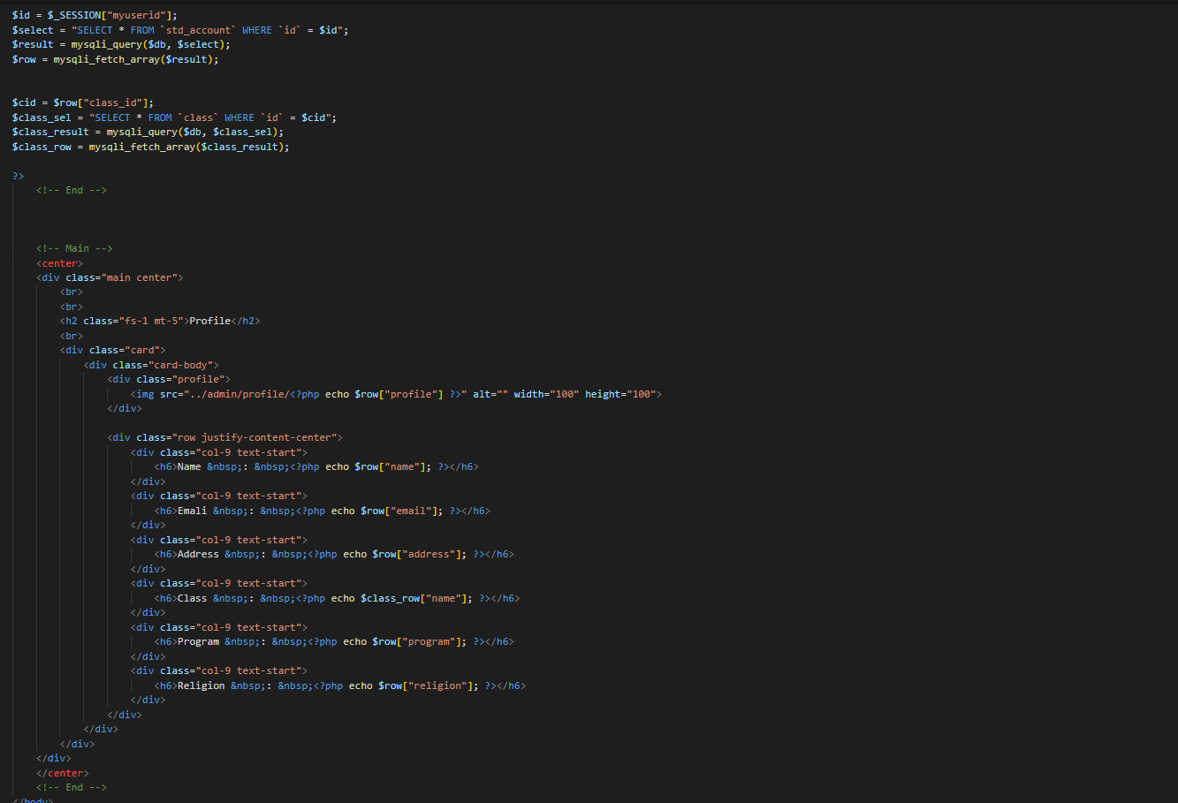
Test Result
profile
22

Slide 33
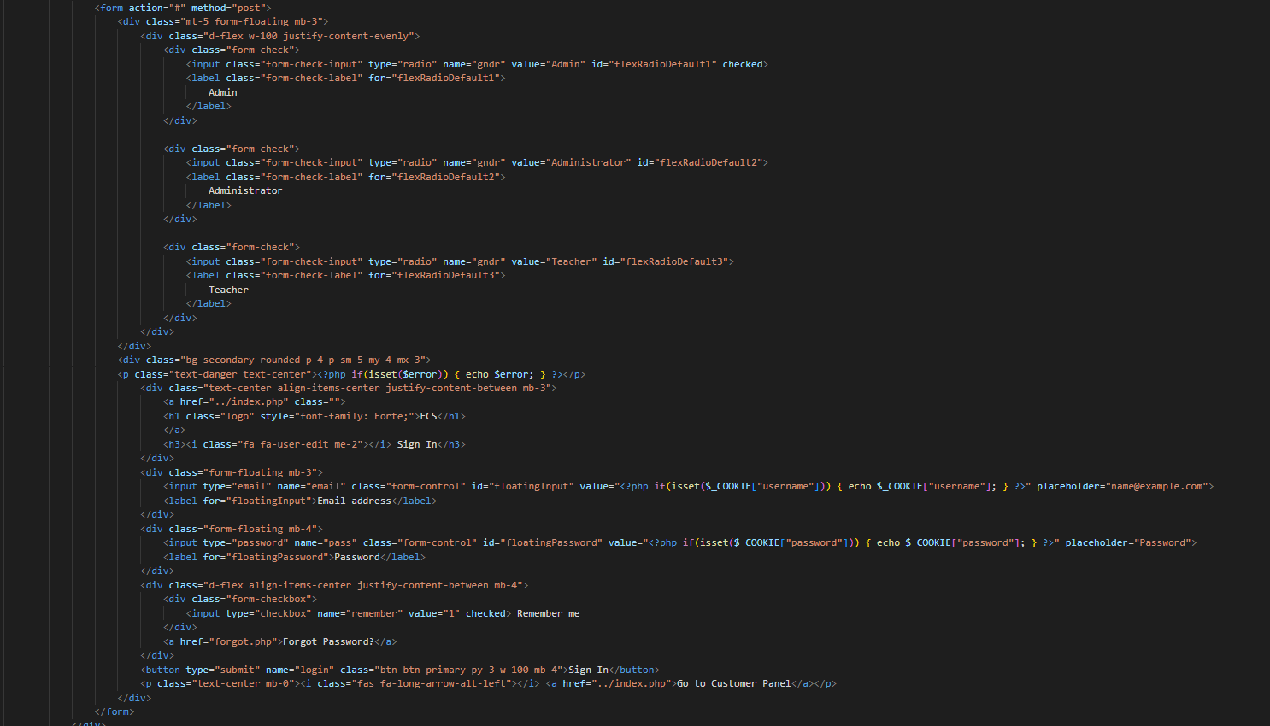
Admin panel
Login
14

Slide 34
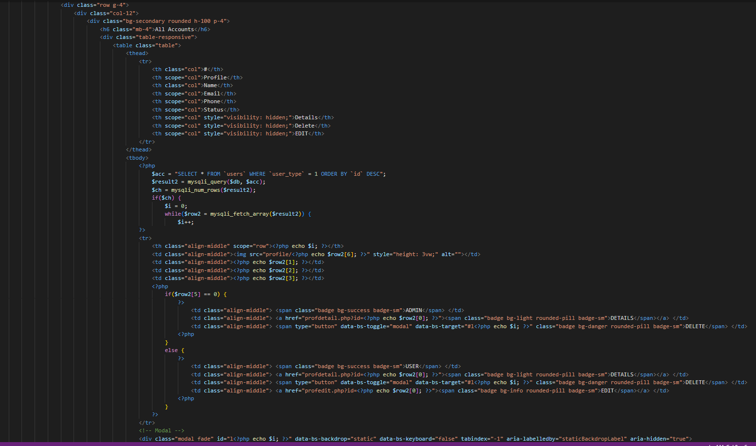
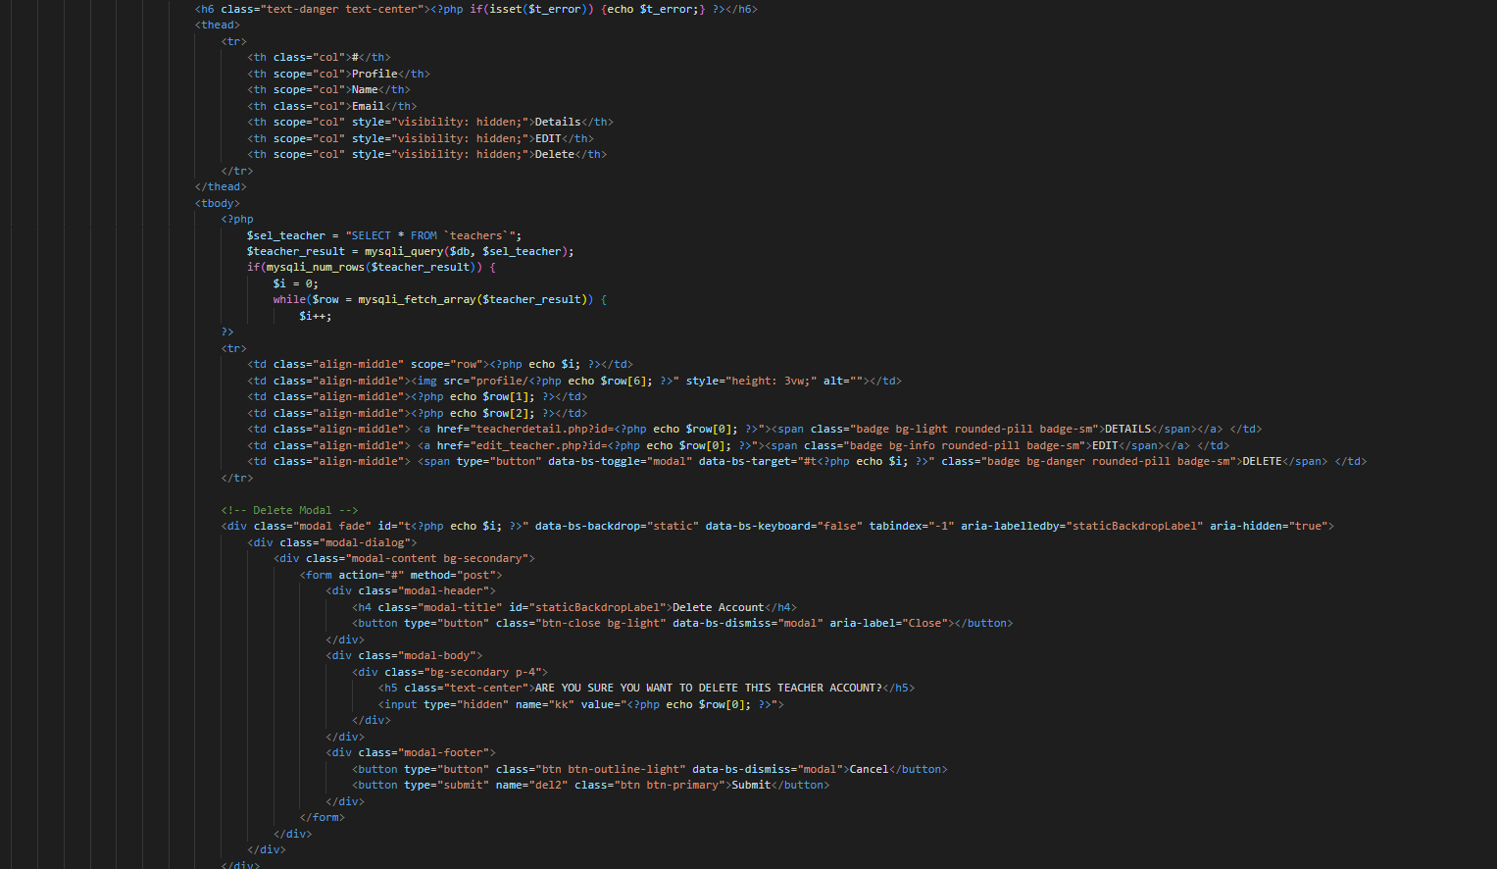
Dashbaord
All accounts
22

Slide 35
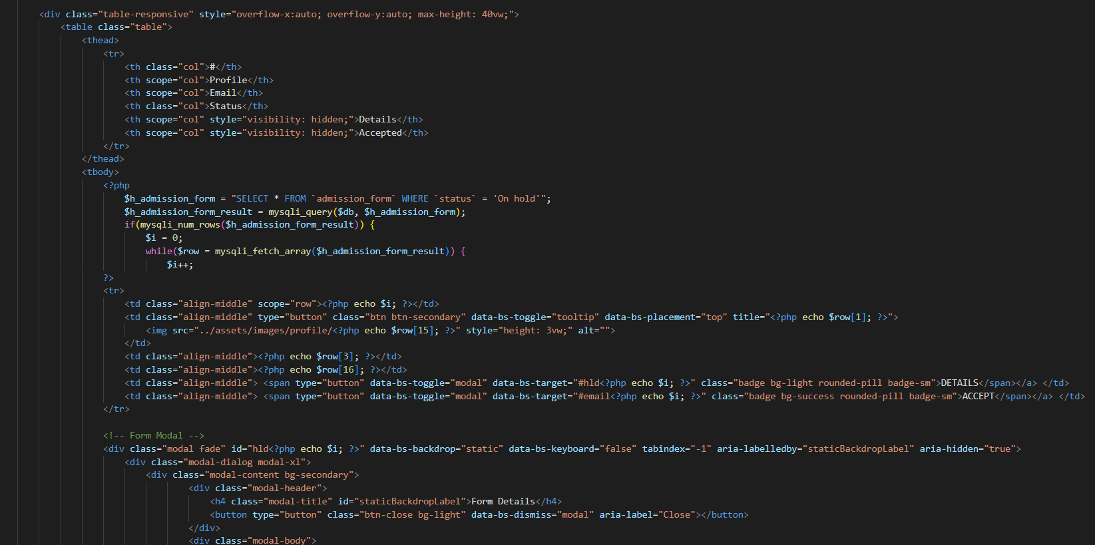
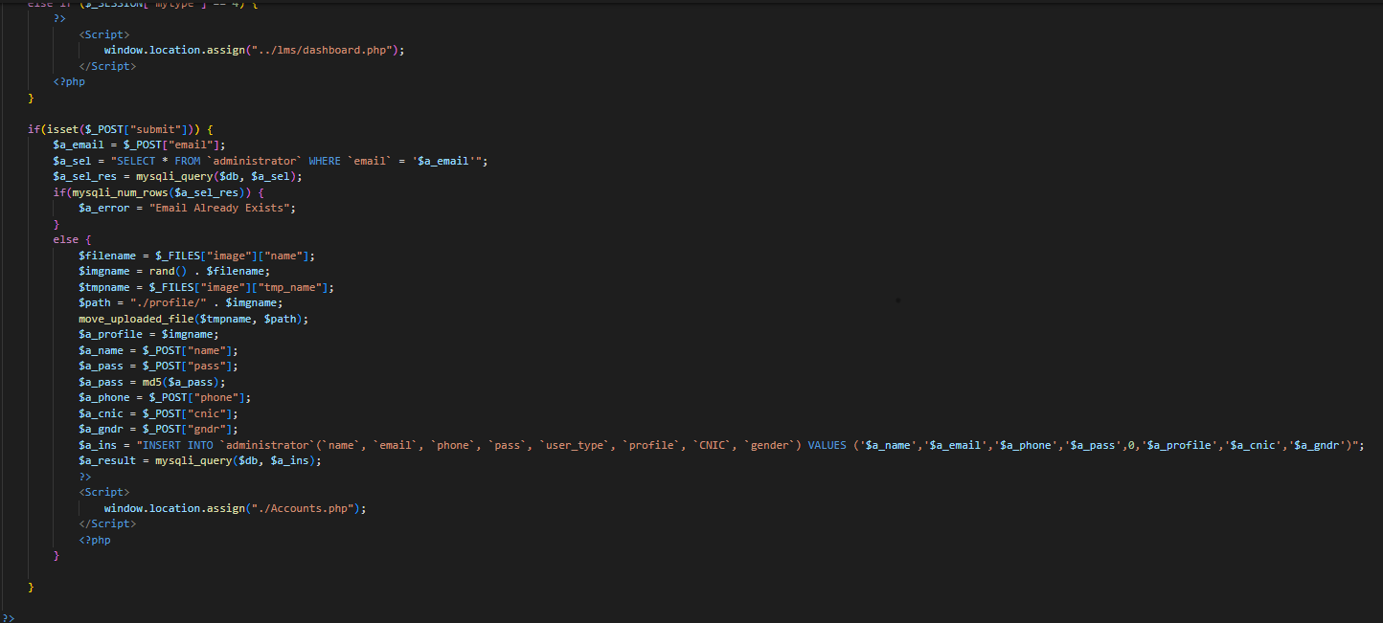
admission
Add administrator
22

Slide 36

2
+

